Slide 1

EXCELERATE
Learner Opportunity
Analysis Report
(https://datastudio.google.com/reporting/eaa5661f-8f42-44c9-a769-ace0c079b084)
Understanding learner engagement and opportunity outcomes through data.
Data Analysis Project
Team 8 |October 2026.
Notes:
Title slide. Replace team name and date.

Slide 2
AGENDA
01
Table of Contents
PART A
PART B
PART C
Foundation
Analysis
Insights
1
Team Charter
3
Dataset Overview
6
Key Dashboard Visualizations
2
Project Overview
4
Analysis Approach
7
Major Findings & Insights
5
Data Cleaning & Quality Improvements
8
Recommendations
9
Conclusion
Excelerate | Learner Opportunity Analysis
Notes:
Agenda grouped into three parts: Foundation, Analysis, Insights.

Slide 3




PART A · FOUNDATION
02
Team Charter
Role | Team Member | Responsibility
Project Lead | Naheemat AKinyemi | Provides overall direction for the project and ensures the team stays aligned with the project objectives.
Team Lead | Ilqha Mabroor Gana Roushan | Guides the team’s work, assigns tasks, reviews progress, and ensures quality.
Project Manager | Laiba Mir | Oversees the project, coordinates tasks timelines, and ensures deliverables are completed.
Project Scribe | Omoze Ogwogho | Documents meetings, decisions, progress, and important project updates.
Team Mission
Deliver accurate, actionable insights on learner engagement and opportunity outcomes that help Excelerate connect more learners with the right opportunities.
WAYS OF WORKING
TEAM VALUES
Accuracy · Collaboration · Clarity
Weekly syncs
Shared workspace
Peer review
Excelerate | Learner Opportunity Analysis
Notes:
Replace names with real team members and adjust responsibilities.

Slide 4


PART A · FOUNDATION
03
Project Overview
BACKGROUND
Excelerate connects learners with growth opportunities. This project analyzes learner and opportunity data to reveal what drives engagement, where learners drop off, and how opportunity delivery can improve.
Objectives
Scope
Success Metrics
Profile learner engagement
Identify drop-off points
Guide opportunity matching
Learner & opportunity records
Descriptive & trend analysis
Dashboard-based reporting
Clean, validated dataset
Insights tied to key KPIs
Actionable recommendations
Excelerate | Learner Opportunity Analysis
Notes:
State the business problem, objectives, scope and how success is measured.

Slide 5
PART B · ANALYSIS
04
Dataset Overview
Two tables profiled separately, then integrated with a LEFT JOIN
5,733
15,397
15,397 × 76
~4years
opportunity_data
33 columns
learner_tbl
43 columns
integrated, all columns text at this stage
Time span across dataset, apply_date.
Join: learner_tbl.sk = opportunity_data.opportunity_id, after normalising the Learner# / Opportunity# format. Learner-side records are kept.
Three levels of measure
Record-level
Every row; not all are applications
Application-level
Only rows with an application_id (completion, acceptance)
Opportunity-level
Fee, duration, scholarship, reward repeat per opportunity; normalise before summing
Excelerate | Learner Opportunity Analysis

Slide 6




PART B · ANALYSIS
05
Analysis Approach
STEP 1
STEP 2
STEP 3
STEP 4
STEP 5
Collect & Prepare Data
Explore Data
Clean Data & Define Objectives
Analyze & Segment
Visualize & Report
Consolidate source files and standardize structure.
Profile distributions, spot gaps, outliers and patterns.
Clean & Set business questions, KPIs and scope with stakeholders.
Compare trends and engagement drivers.
Build dashboards and translate findings into actions.
TECHNIQUES
Descriptive statistics
Segmentation
Trend analysis
Correlation analysis
Excelerate | Learner Opportunity Analysis
Notes:
Walk through the five-step workflow from objectives to reporting. Adjust techniques to match what was used.

Slide 7
Exploratory Findings: Opportunity Structure
06
Based on 5,733 opportunity listings
46.7%
78.8%
74.8%
Internship (27.75%) + Career (18.98%) of all listings
no fee charged: 4,518 of 5,733 opportunities
of duration records are week / weeks; months, days, hours, minutes and years need standardising
Fee outliers: A handful of extreme outliers 3 rows above $10,000 up to a genuine $200,000, plus one corrupted value of $6,000,000,000,000 written in scientific notation would badly distort any average-fee calculation if not excluded separately.
Corrupted listings: 3 of 5,733 raw records (0.03%) held leaked UI / form-configuration content and were flagged, not interpreted.
Excelerate | Learner Opportunity Analysis

Slide 8
Exploratory Findings: Participation
07
Different denominators for different metrics
8,529 unpaid · 6,363 paid
Paid conversion uses only records with a payment status; blanks are not counted as unpaid.
Application Level
Only 10.76% of records contain a value in application_id, and the field includes question responses and placeholders rather than reliable IDs. However, its presence provides a useful indicator of application-stage progression while acknowledging the field's data-quality limitation.
Completion = completed ÷ application-bearing records (not all records).
Excelerate | Learner Opportunity Analysis

Slide 9
08
Data Cleaning: Integrity & Identifiers
What was found and how it was treated
Issue | What was found | Treatment
Learner pk | 5,730 of 15,397 records (37.2%) were linked to a distinct learner PK containing only a bare Learner# value, separate from the damaged PK records. In addition, 368 records had blank learner IDs, while 236 contained corrupted values such as Base64 or JSON fragments. | sk used independently of damaged pk; 5730 sk tied to distinct bare learner_ID + 368 blank + 236 corrupted rows removed (unrecoverable)
Unmatched join | 598 learner records had no opportunity match | Matched the records removed in identifier cleaning; a data-quality finding, not proof of non-applicants
Exact duplicates | 538 of 15,397 rows (3.5%) identical across all 76 columns | Deduplicated to keep one copy; audited separately.
Application_id | Populated in 1,657 rows (10.76%), only 248 distinct values; includes essay text and placeholders such as 111111 | Not used as a row key; application metrics use only rows with a usable value, with limits noted
Duration | 139 records (15 opportunities) had a duration over 4 years, using duration and duration_type. | Values are flagged errors and record were removed
Role(Test) | 447 records (112 opportunities) had a role containing "test". | Test records are flagged not real activity and removed.
Excelerate | Learner Opportunity Analysis

Slide 10
09
Data Cleaning: Types, Nulls & Categories
Standardising values so filters and comparisons are reliable
Issue | What was found | Treatment
Text-typed columns | All 76 columns text; AVG(fee) failed with "avg(text) does not exist" | Explicit type conversion; fee validated to a usable range (6-trillion value excluded)
Literal "null" | "null", "Null", "NULL" text: 3,720 integrated location rows; 466 in the opportunity table | Converted to true SQL NULL
Inconsistent categories | Location had 23 spellings; duration_type had week/weeks, month/months, "da", "yearssss"; EUR vs EURO | Location reduced to 3 values; six duration units; EURO mapped to EUR
Export corruption | 10–12 records across both tables with leaked JSON / form-config text | Flagged and quarantined, not reconstructed
Fee / category mismatch | ~9,050 apparent mismatches across 14,799 matched rows; learner-side blank in 62.7%; only 5 genuine conflicts | Opportunity-side values treated as authoritative; the 5 conflicts kept for review
Excelerate | Learner Opportunity Analysis

Slide 11
Data Quality Improvements
10
What the cleaned data now guarantees
01 Analysis-ready types
02 Reliable records
03 Consistent missing values
Text dates, numbers and categories converted
Blank, corrupt and duplicate rows excluded
Text "null" became real NULL
04 Clean categories
05 No double counting
06 Right populations
Spellings, units and labels unified
Scholarship and reward values normalised per opportunity
Sign-ups kept separate from applications; minimum of 5 applications for opportunity comparisons
Excelerate | Learner Opportunity Analysis

Slide 12
Net Effect of Cleaning
11
15,397 → 8482 rows
Metric | Before | After
Total rows | 15,397 | 8482
Blank identifier rows | 368 | 0
Corrupted identifier rows | 236 | 0
Literal "null" locations | 3,720 | 0
Location spellings | 23 | 3
COUNT(DISTINCT pk) | 597 | 551
COUNT(DISTINCT opportunity_ID) | 5733 | 3045
6915 removed on the identifier criteria (368 blank, 236 corrupted, 5730 bare learner identifier, 447 Role(test), 139 duration over float(>4ears)).
The 538 duplicates were audited separately and are not an extra 538 removed unless the final dedup step removed them.
Excelerate | Learner Opportunity Analysis

Slide 13
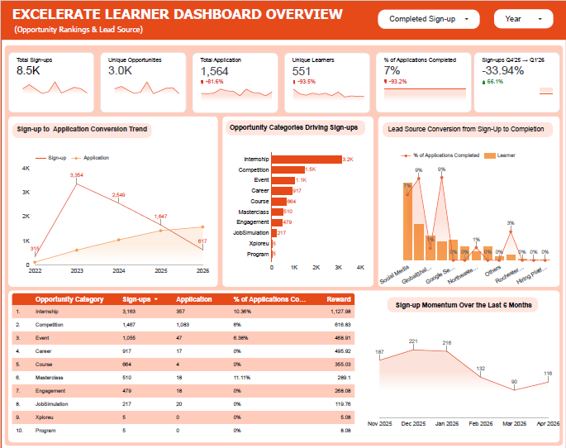
Dashboard 1: Overview, Opportunity Rankings & Lead Source
1
KPI cards
8.5K sign-ups, 1,564 applications, 551 learners; ~7% of applications completed; sign-ups −33.94% Q4 2025 to Q1 2026.
1
2
Conversion trend
Applications climb across the year while sign-ups spike and fall: they do not move together.
2
3
4
3
Categories & ranking table
Internship: 3,163 sign-ups, 10.36% completed. Competition: 1,083 of 1,564 applications. Course: 664 sign-ups, 4 applications. Masterclass tops at 11.11%, on only 18 applications.
4
Lead sources
Social Media is the largest source but only ~7% completed: volume is not conversion.
3
5
5
Six-month momentum
187 → 221 → 216 → 132 → 90 → 116 sign-ups (Nov to Apr): peak in Dec, low in Mar, partial rebound in Apr.
Notes:
Talk track: reach vs progression (551 learners, 1,564 application-stage records, ~7% completion). Masterclass has the highest completion but a small sample (~510 sign-ups, 18 applications). Internship attracts thousands of sign-ups at 10.36% completion. Course: 664 sign-ups, 4 application records, no completion. Monthly sign-ups: Nov 187, Dec 221, Jan 216, Feb 132 (-38.9% vs Jan), Mar 90 (-31.8%), Apr 116 (+28.9%). Insight: acquisition and progression differ; the changes should be examined alongside launches, campaigns and lead sources. Also note Competition drives about 69% of application-stage records (1,083 of 1,564), which pulls the overall rate toward its 6%.

Slide 14
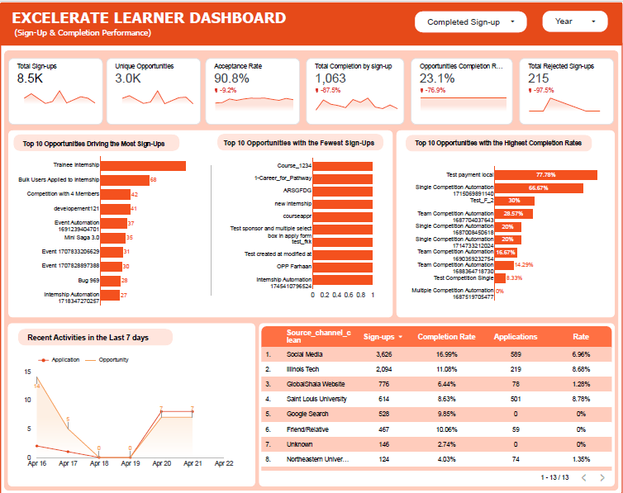
Dashboard 2: Sign-Up & Completion Performance
1
KPI cards
90.8% acceptance rate, 215 rejected sign-ups, and 23.1% opportunity completion rate(not 7% completed application).
1
2
Sign-up extremes
Trainee Internship drives the most sign-ups; the fewest-sign-up list is mostly test or placeholder records.
2
3
3
Highest completion rates
Led by small or test records (Test payment local 77.78%), so read rates against volume. Training Internship is not among the top performers.
4
Lead source table
Social Media: 3,626 sign-ups, 6.96% completed. Illinois Tech: 2,094, 8.68%. Saint Louis Univ.: 614, 8.78%. Google Search: 528 sign-ups, 0 applications.
4
5
5
Last 7 days
Application activity fell to zero on Apr 18–19 and returned to 7 on Apr 20.
Notes:
Talk track: completion performance was assessed with a minimum of five sign-ups per opportunity to avoid misleading rates from tiny volumes; test and payment-related records were excluded from meaningful top-opportunity comparisons. Single and Team Competition Automation appear among stronger completers. Lead source: judge sources on sign-up to application to completion, not volume. Social Media generated 409 distinct learners with ~7% progressing; Saint Louis University ~97 learners with ~9%. The last-7-days chart shows application activity, not sign-ups. Insight: popularity and completion are not aligned.

Slide 15
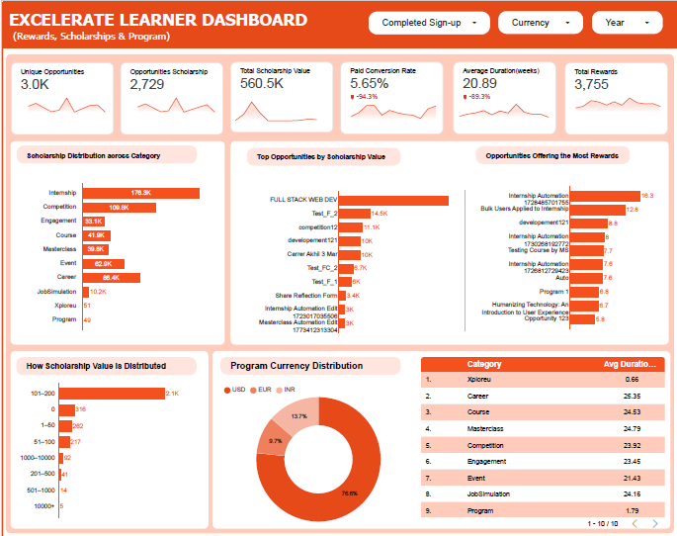
Dashboard 3: Rewards, Scholarships & Program
1
KPI cards
2,729 scholarship opportunities, 560.5K scholarship value (currencies not converted), 3,755 rewards, 5.65% paid conversion.
1
2
Scholarship by category
Internship 176.3K, Competition 109.8K and Career 86.4K lead; Course 41.9K and Job Simulation 10.2K are low.
2
3
3
Top opportunities
Scholarship and reward leaders are different opportunities; Full Stack Web Dev topping with 50k Internship Automation tops rewards (16.3).
4
Value distribution
Most scholarship records sit in the 101–200 band (~2.1K); 316 carry zero value.
5
4
5
Currency & duration
USD 76.6%, EUR 13.7%, INR 9.7%. Average duration is 21–25 weeks for most categories.
Notes:
Talk track: rewards and completion measure different things. Internship has the highest reward activity (1,127.98) while Xploreu has the lowest and no application activity. Competition earned more rewards (616.83) than Masterclass (289.1), yet Masterclass completes better (11.11% vs 6%). Scholarship support is concentrated in Internship, Competition and Masterclass; compare against demand, applications and completion. The 560.5K total adds values recorded in different currencies, so treat amounts as currency-specific unless converted.

Slide 16
Overall Findings
Detail for each point is explained on the dashboard
1
High participation does not translate into progression
Only 1,564 application-stage records identified and about 7% completed: large movement loss across the funnel
2
Opportunity volume differs from effectiveness
Internship and other high-volume opportunities attract many learners, but sign-ups do not track completion
3
Participation is declining and fluctuating
Sign-ups fell 33.94% from Q4 2025 to Q1 2026; monthly activity swings sharply
4
Lead-source volume is not lead-source effectiveness
Social Media brought the largest identifiable learner group, but its downstream progression was limited
5
Rewards and scholarships are not aligned with completion
Their distribution does not match completion performance, so incentives may not reach engaged learners
Excelerate | Learner Opportunity Analysis

Slide 17
Priority Recommendations for Institutions
Ordered by priority
1
Close the funnel gap
Track sign-up → application → completion and add targeted support at the weakest step
2
Rank opportunities by completion, not sign-ups
Scale or redesign opportunities using completion rate, with a minimum-application threshold
3
Diagnose and stabilise the sign-up decline
Investigate the Q4 2025 to Q1 2026 drop and plan campaigns around monthly swings
4
Invest in lead sources by conversion
Shift acquisition effort toward sources that progress learners, not just recruit them
5
Align rewards and scholarships with outcomes
Review who receives incentives and pilot awards linked to engagement and completion

Slide 18
Conclusion
The opportunity is not just more sign-ups. It is helping more learners move forward.
8.5K
→
1,564
→
~7%
Sign-ups
Applications
Completed
Strong participation
Far fewer move forward
Few finish
What to keep monitoring
Learner acquisition
Application progression
Completion
Rewards
Scholarship support
Together, these show where an intervention will make the biggest measurable difference.
Dashboard Link: (https://datastudio.google.com/reporting/eaa5661f-8f42-44c9-a769-ace0c079b084)

